Slide 1
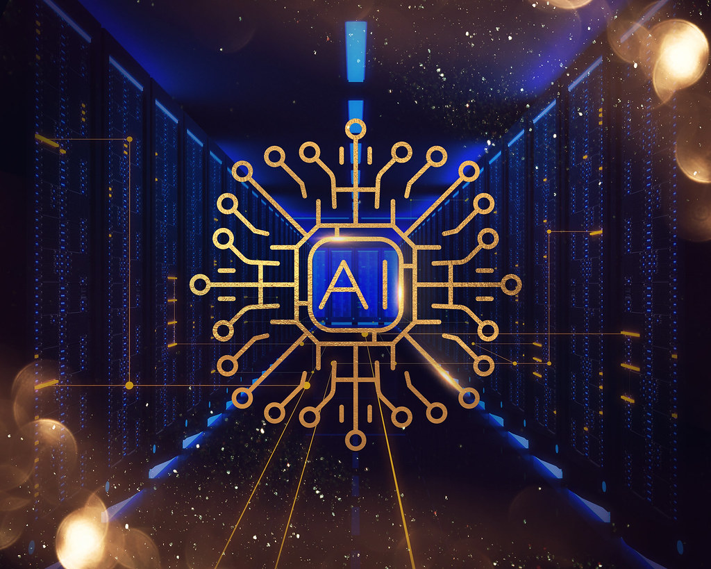

Course Name: English Reading Skills And Public Speaking Title: Artificial Intelligence Presentation Submitted To: Farhat Tasannum Farah Assistant Professor Submitted By: Name: Rifah Sanzida ID: 22-47154-1

Slide 2
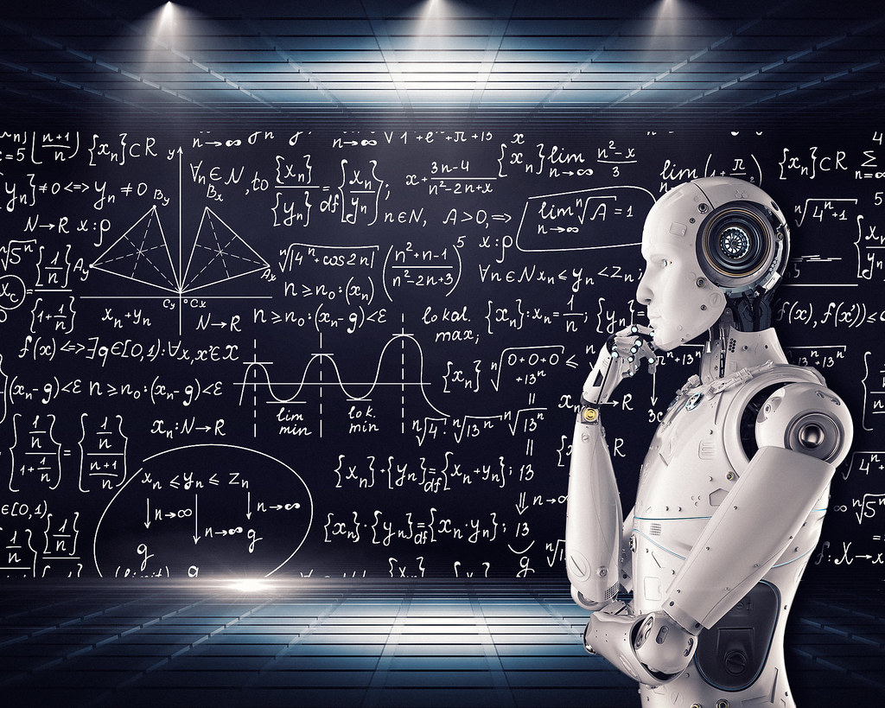
Contents *Definition *Early History *Types of AI *Goals of AI *Application of AI *Future of AI *Conclusion
This Photo by Unknown author is licensed under CC BY.

Slide 3
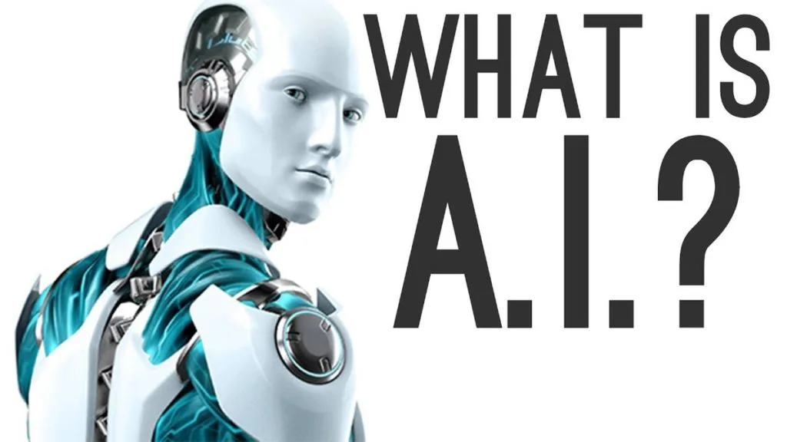
Artificial Intelligence (AI) is the simulation of human intelligence by machines.

Slide 4
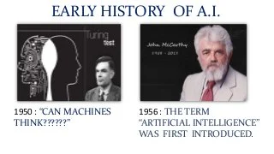

Slide 5
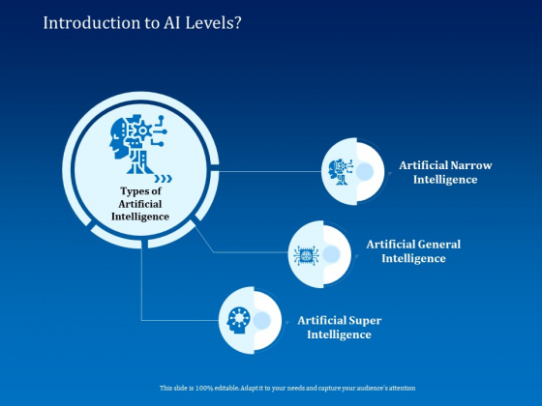

Slide 6
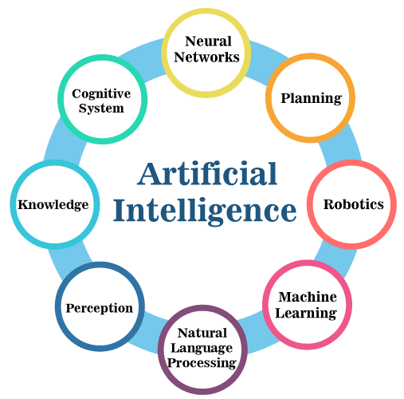
Goals of AI

Slide 7

Applications of AI in healthcare
Improve decision making
Help in treatment
Associated care

Slide 8

Applications of AI in education
Admin tasks
Voice assistants
Smart content

Slide 9
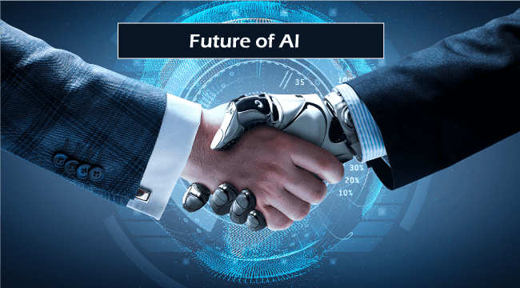
Connecting students with global classrooms
Improved medical care & treatment
Open up doors to future explorations

Slide 10

Conclusion
Finally, we can say that AI is the intelligence of the machine in the branch of computer science that aims to create it.
John McCarthy who coined the term "Science and Engineering are making Intelligent Machines".

Slide 11

Do you have any questions?

Slide 12
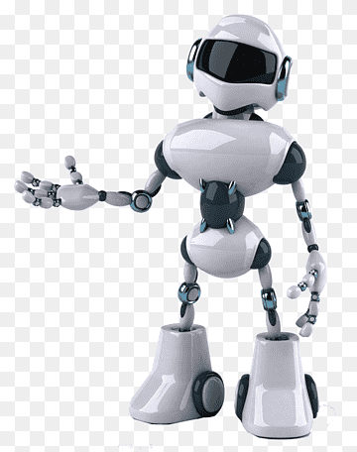
Thank you For listening to me

